Slide 1
Seeing the light
A shoebox has some holes cut in it.
Shoebox

Slide 2
Seeing the light
Predict
The torch is pointed in the direction shown.
Which hole(s) do you think the torch will light up?
1
Explain
Draw a diagram to show why you think you will see this
2
3

Slide 3
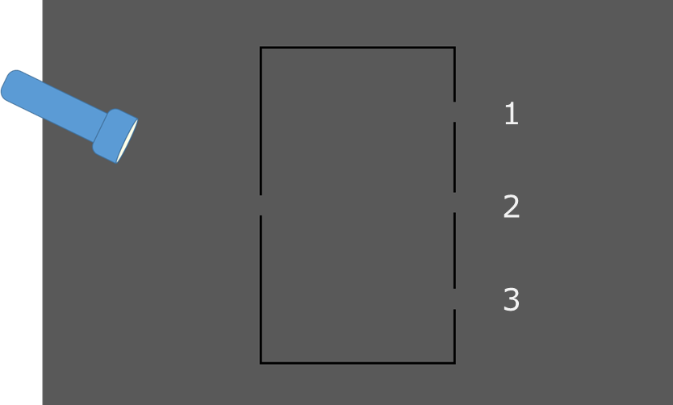
Seeing the light
Observe the demonstration
Observe
Record what you see
Explain
Were your prediction and explanation correct?
If not, can you explain what you observed?

